Slide 1



Introduction to the Present Perfect
The Present Perfect is a verb tense in English that describes an action that began in the past and continues in the present or has a result in the present. This tense is used to express experiences, completed actions, and situations that started in the past but have implications for the present. It's important to understand this tense to communicate effectively in English.
HP
by Héctor Pérez

Slide 2
Present Perfect Structure
The Present Perfect tense is formed with the auxiliary verb "have" or "has" followed by the past participle of the main verb. For example, "I have eaten" or "She has finished".
Subject
Auxiliary Verb
Past Participle
The subject of the sentence performs the action.
The auxiliary verb "have" or "has" is used to form the tense.
The past participle of the main verb is used to indicate completion of the action.

Slide 3

Negative Present Perfect
To form the negative Present Perfect, add "not" after the auxiliary verb "have" or "has". The sentence then becomes a statement of something that has not happened.
1
Structure
2
Example
Subject + have/has + not + past participle + object
I have not eaten breakfast today.

Slide 4
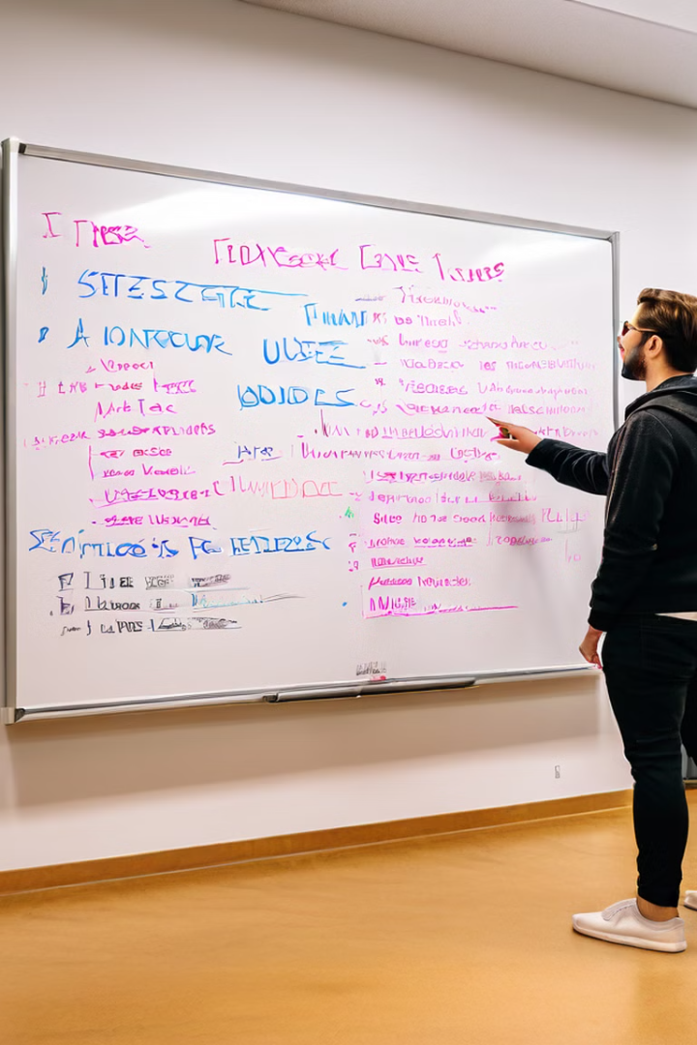
Positive Present Perfect
The positive Present Perfect is used to express actions that have been completed in the past, with a focus on the present result. This tense emphasizes the completed action's impact on the present.
1
Structure
2
Example
Subject + have/has + past participle + object
She has finished her homework.

Slide 5
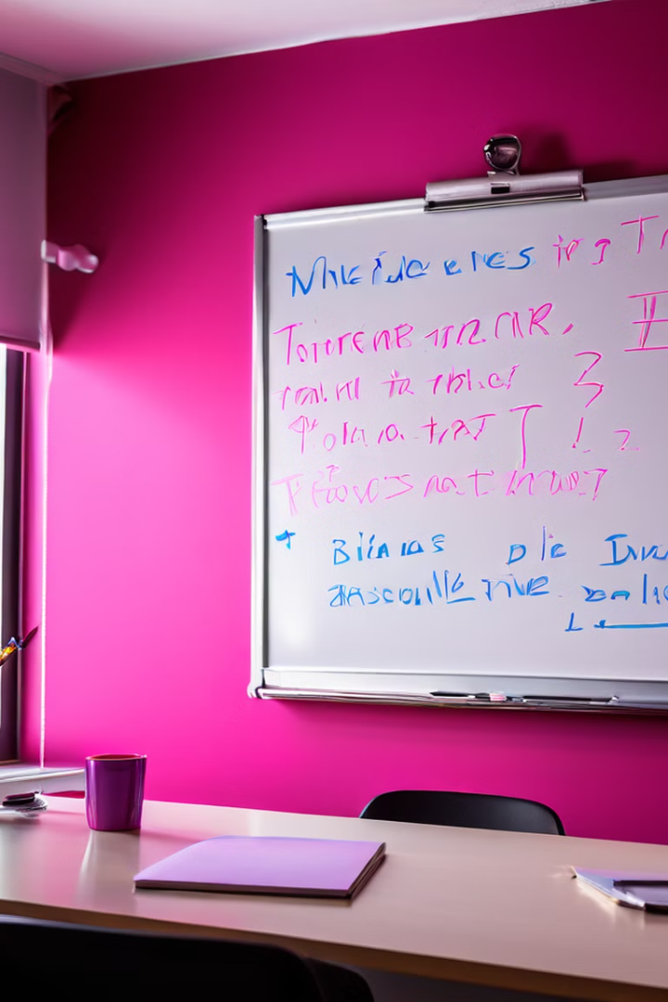
Interrogative Present Perfect
To form the interrogative Present Perfect, move the auxiliary verb "have" or "has" to the beginning of the sentence. This creates a question seeking information about an action that has been completed.
1
Structure
2
Example
Have/Has + subject + past participle + object?
Have you seen the new movie?

Slide 6

Present Perfect Examples
The Present Perfect is a versatile tense that can be used in various contexts. It is often used to describe experiences, completed actions, and situations that started in the past but have implications for the present. Here are some examples of how to use this tense.
I have eaten breakfast.
We have visited the museum.
They have lived in London for many years.
He has finished his studies.

Slide 7




Practice Exercises
Practice is essential for mastering the Present Perfect tense. Here are some exercises to help you solidify your understanding and apply what you've learned.
Exercise 1
Complete the sentences with the correct form of the Present Perfect:
Exercise 2
Write 10 sentences in the Present Perfect about your experiences.
Exercise 3
Write 5 questions in the Present Perfect about your friends' experiences.

